Slide 1


STARK Programming Language
By
Debarati Bhattacharyya (ASU ID : 1207688959)
Janani Thiagarajan(ASU ID : 1213296368)
Shilpa Bhat (ASU ID: 1212901948)
Vivek Faldu (ASU ID : 1214392296)

Slide 2
Contents
Introduction
Getting Started
Grammar Rules
Features & Design
Sample Programs
Intermediate Code
Runtime Generation
Development Process
Future Improvements

Slide 3
Introduction
STARK is a static, strongly typed imperative programming language. The word “Stark” means simple and powerful which are the main design goals. It is easy to learn and provides all the major features of a high level language.
Tools:
ANTLR 4
Lexical analysis – tokenization
Parser generation – parse tree
Java 8
Compiler is written in Java
Interpréter and Runtime environment use JRE
Data Structures used : Stack and Hashmap

Slide 4
Getting Started
We will first take a look at the processing of a STARK program.
The source code will be given to lexical analyzer to generate the tokens
The generated tokens are then given to parser to build a parse tree
The parse tree would be given semantics to generate an intermediate code
The intermediate code is then interpreted by the runtime environment to generate an output
The source code in STARK will be compiled and executed in two steps :
Compile the source code to generate the intermediate code
Interpret the intermediate code to produce the final output

Slide 5
STEPS TO RUN STARK
STARK programs can be written and saved with any standard editor such as Notepad etc.
Download STARK.jar from the git repository
Follow the below steps to compile and execute your STARK programs:
Windows Users :
Use Windows Command Prompt from the location of stark.jar
Use the command for compiling your STARK source code:
java -jar stark.jar -c sourcePath intermediateCodePath
This will generate and display the intermediate code path with Intermediate code file name
intermediateCodePath programName.iark
Use the command for executing your STARK intermediate code:
java -jar stark.jar -e intermediateCodePath programName.iark

Slide 6
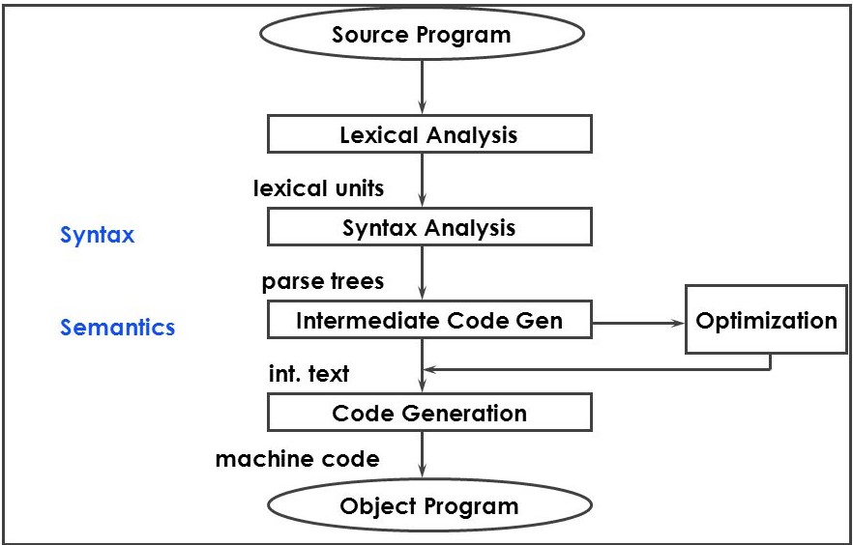
BLOCK DIAGRAM FOR SOURCE CODE PROCESSING
1. Lexical Analysis:
Input : source code
Output : lexical units or tokens
2. Parser:
Input : token string
Output : parse tree
3. Bytecode:
Input : parsing tree
Output : generate intermediate code

Slide 7
GRAMMAR FOR STARK
STARK supports a wide range of arithmetic and relational operators. Besides this, it also supports logical operators.
STARK has two primary datatypes :
int – used for positive numeric integers such as 0,1,2 and so on
bool – used for boolean values such as ‘true’ and ‘false’
Identifiers are symbols used to uniquely identify a program element in the code. STARK identifiers are alphanumeric elements but they must begin with a character
STARK also incorporates conditional statements like if, if-else and iterative constructs like while loop
With STARK, user can define and use their own functions to perform certain tasks
Each valid STARK statement must end in a ‘;’
Comments can be added with ‘//’ and ‘/*……*/’ for multi line comments

Slide 8
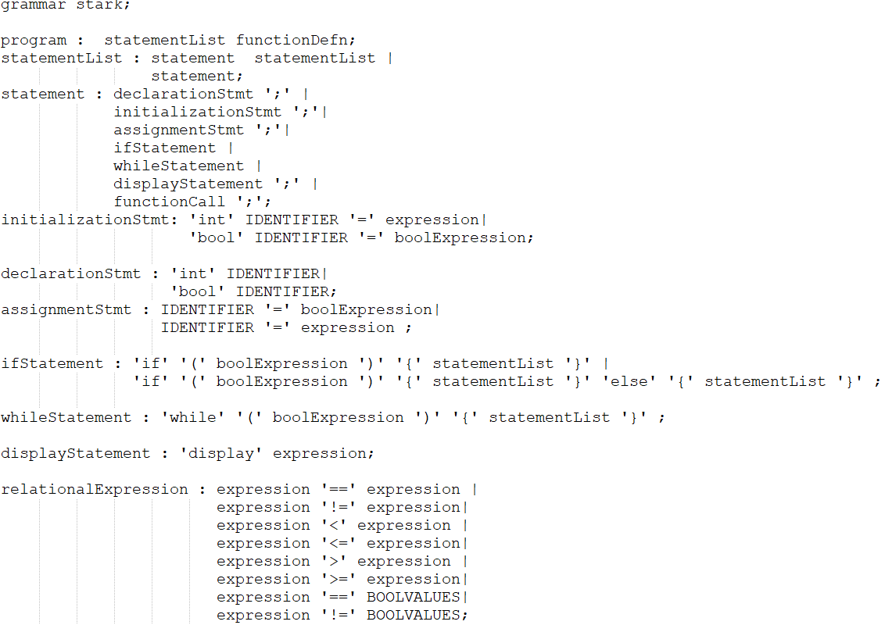

Slide 9
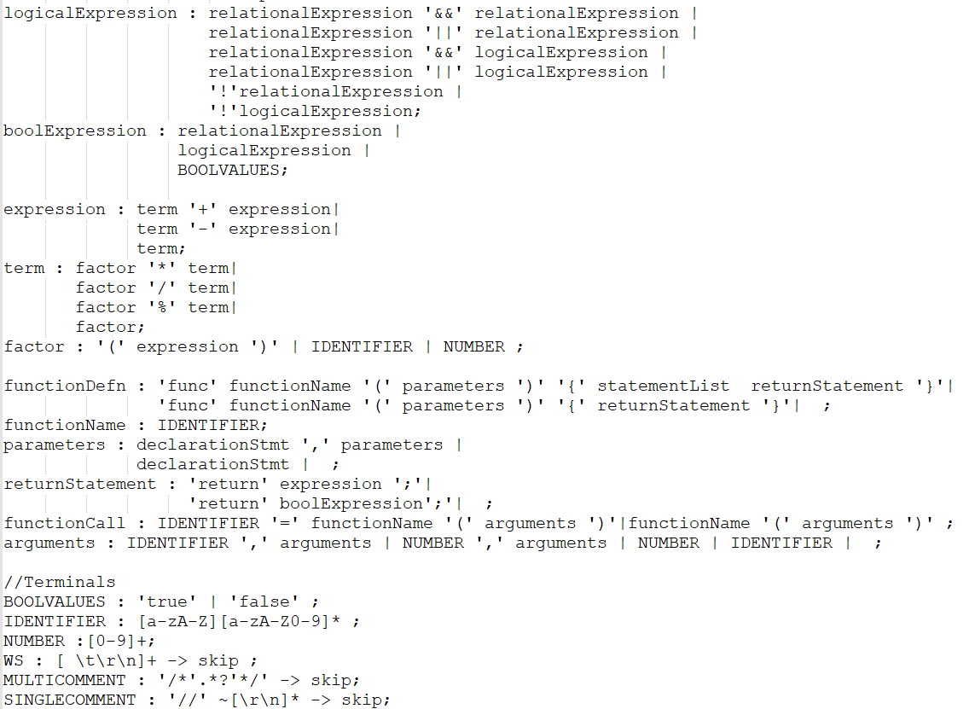

Slide 10
Datatypes Supported
Stark supports integer(int) and boolean(bool) datatypes.
Operations related to these datatypes are supported as well
Operations supported for int
Addition, Subtraction, Multiplication, Division and Modulus operator (+ - * / %)
Stark also supports relational operator like > , <, >=, <=, ==, != to compare two integer values
Operations supported for bool
Logical operators like && (logical AND), || (Logical OR), ! (Logical NOT)

Slide 11
OPERATORS IN STARK : OVERVIEW
Arithmetic :
Operator | Name | Operand | Function
+ | Addition | a + b | Adds two numbers
- | Subtraction | a – b | Subtracts two numbers
/ | Division | a / b | Divides two numbers
* | Multiplication | a * b | Multiplies two numbers
% | Modulus | a % b | Returns the remainder when a is divided by b

Slide 12
OPERATORS IN STARK : OVERVIEW
Relational and Logical :
Operator | Name | Operand | Returns True If
< | Less than | a < b | a is less than b
> | Greater than | a > b | a is greater than b
<= | Less than or equal to | a <= b | a is less than or equal to b
>= | Greater than or equal to | a >= b | a is greater than or equal to b
== | Is equal | a == b | a is equal to b
!= | Not equal to | a != b | a is not equal to b
&& | Logical AND | a && b | Both a and b are true
|| | Logical OR | a || b | Either a or b is true
Besides this, we also support ‘!’ which is the logical NOT operator. For eg: !a will compliment the value stored in a.

Slide 13
IDENTIFIERS
Identifiers are a sequence of one or more characters. Consecutive characters in the identifiers are optional and could comprise of alphanumeric characters but should begin with an alphabet.
IDENTIFIER : [a-zA-Z][a-zA-Z0-9]*
Eg : a, sum, num2

Slide 14
VARIABLES
Variables are used to store data values of a certain type- int or bool values
The stored value of variables can change during program execution.
Stark supports variable declarations , initialization and assignments operations
Variables should be declared or initialized before they can be used. Else Stark gives compiler error
Sample usage
int a; a=10;
int a=10;
bool b = true;
bool b;

Slide 15
Expressions
Stark supports the following types of expression
Numeric expressions
Relational expressions
Logical expressions
Relational and logical expressions together form boolean expressions i.e. they return a boolean value based on the operation
Numeric expressions handle precedence in the following order
*, /, %
+, -
They are left associative as well.

Slide 16
STATEMENTs
Stark statements could be any of the following :-
Declaration statement
Assignment statement
Initialization statement
If Statement (Also Nested IF)
If – Else Statement (Also Nested IF-ELSE)
While Statement (Also Nested WHILE)
Display Statement
Function call
Single line and multi-line comments are also supported

Slide 17
Declaration statement
Declaration should be in the following format :
Datatype <varName>;
Example –
int count;
bool isZero;

Slide 18
Initialization statement
To initialize a variable , the following format has to be followed
dataType variableName = Value ;
Example –
int count = 0;
bool isZero = false;

Slide 19
ASSIGNMENT STATEMENT
Assignment statement helps assign a value to a variable. It can be used in the following format
variableName = Value ;
Example –
count = 0;
isZero = false;

Slide 20
DISPLAY STATEMENT
Value of an expression or a variable can be displayed using the display statement
display expression;
Example –
display sum;
display a+b;

Slide 21
If Statement
Stark supports if condition in the following format
if(condition) {
Statement list;
}
Example : if(count>10) {
count = count – 1;
}
Nested If is supported.
Example – if(count>10) {
count = count -1;
if(count>5) {
display count;
}
}

Slide 22
If else statement
If else can be used in the following format.
if(condition) {
statementlist;
} else {
statementlist;
}
Example
if(count>10) {
count = count – 1;
} else {
display count;
}
Nested if-else is also supported.

Slide 23
While Statement
While statement can be used in the following format.
while(condition) {
statementlist;
}
Example
while(a>5) {
display a;
a = a-1;
}
Nested while is also supported.

Slide 24
Function call
Function call can be used in the following format
identifier = functionName(arguments) *arguments are optional
or
functionName(arguments) *arguments are optional
Functions may or may not return a value. Function returning a value should be assigned to a variable of appropriate data type
Example:
int sum; sum=add(a,b);
add(a,b);
add(5,10);
Arguments can be of same or different data types

Slide 25
FUNCTION DEFINITION
Function definition can be used in the following format
func functionName(parameters) { statementList; returnStatement }
or
func functionName(parameters) { returnStatement } *parameters are optional
Example:
func add(int a,int b){
int c = a+b;
return c;
}
All the variables in the functions are locally scoped
Parameters can be of same or different data types

Slide 26
Return statement
Return statement can be used in the following format to return value from a function
return expression
Example –
return count;
return a+b;

Slide 27
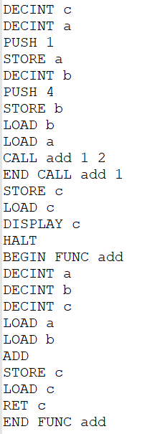
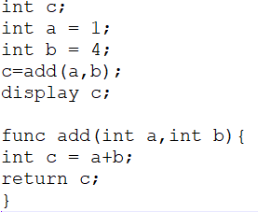
Sample program with intermediate code

Slide 28
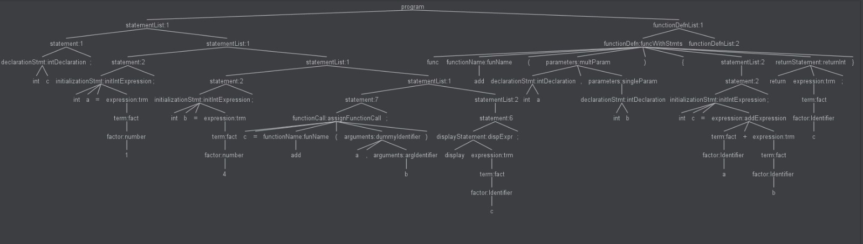
SAMPLE PARSE TREE

Slide 29
Future improvements
The popularity of a programming language depends to some extent, on its designer’s willingness to extend its features. On this note, we would like to improve the following for STARK in future :
Support more data types and unary operators
Support additional looping constructs
Support data structures like array and stack
Support recursion for user-defined functions

Slide 30
REFERENCES
Kenneth C. Louden and Kenneth A. Lambert, Programming Languages Principles and Practice, Third edition, Boston. Cengage Learning, 2011
Alfred V. Aho and Ravi Sethi, Compilers Principles, Techniques and Tools
Antlr4 documentations
SER502 Spring2018 lecture slides

Slide 31
ACKNOWLEDGEMENT
We express our sincere thanks to our professor Mr. Ajay Bansal and his teaching assistant Xiangyu Guo for their continued support and encouragement. We appreciate the learning opportunities they provided to us.
Thank You!

